Slide 16
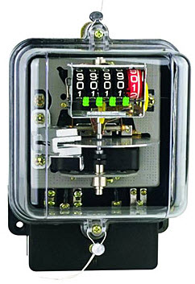

Slide 25
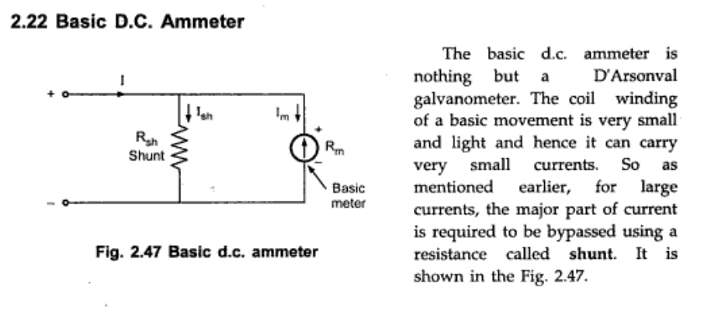

Slide 29
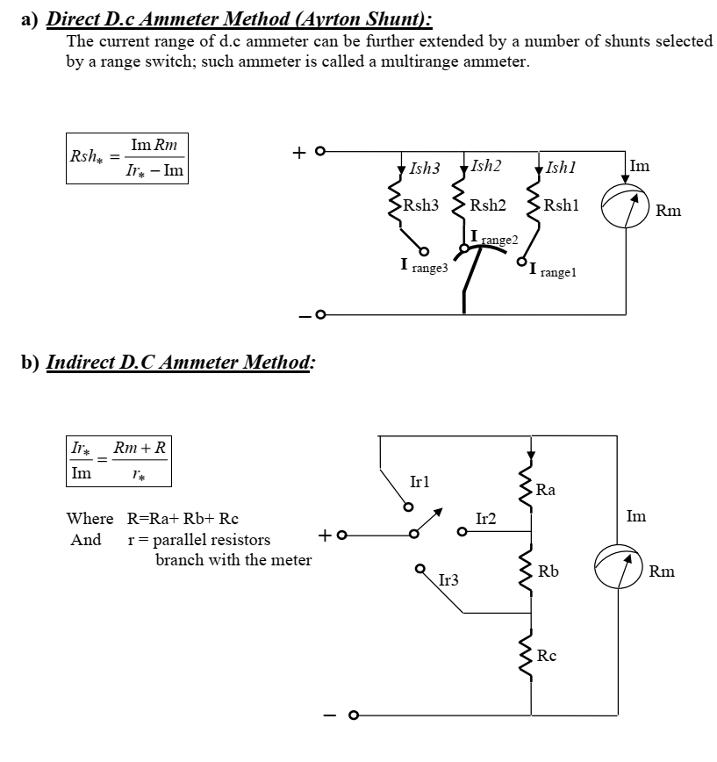

Slide 47
(2-15 to 2-22)

Slide 48
bridge

